Slide 1

Vehicle Prices Data Exploration
By: Kevin Mohammed

Slide 2
Purpose
How vehicles depreciate as they age?
How do sports cars compare to economy cars?

Slide 3
Data set used
Data was Tidy
Did not need to reformat
Dimensions: 50,000x7
No NA's
Interested variable is Price

Slide 4
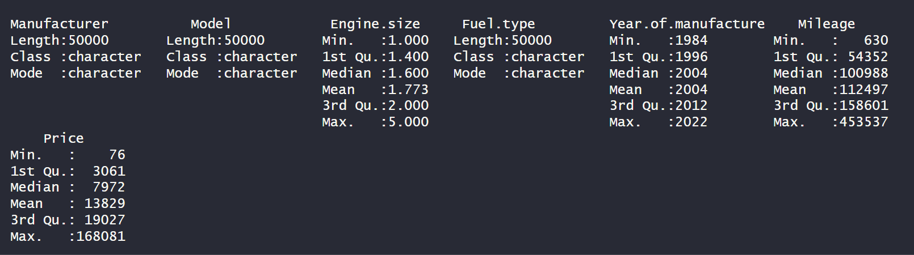
Notable statistics
Outliers present in price

Slide 5
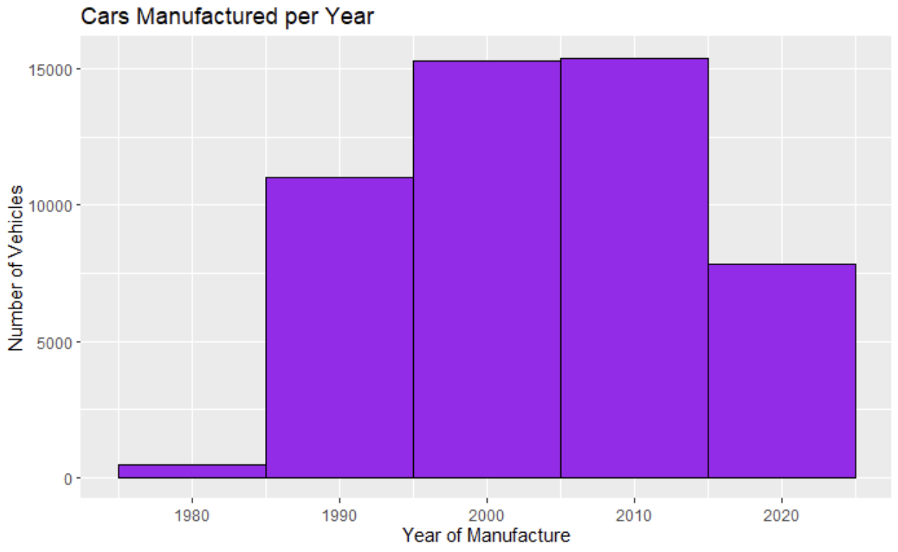
Vehicles Produced each Decade

Slide 6
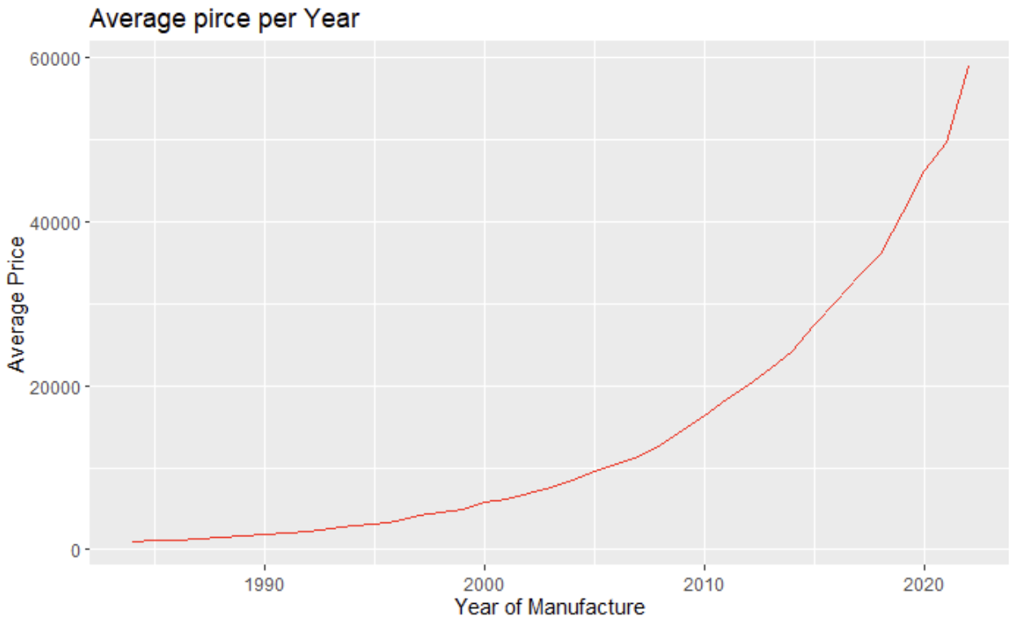
Average Vehicle Prices

Slide 7
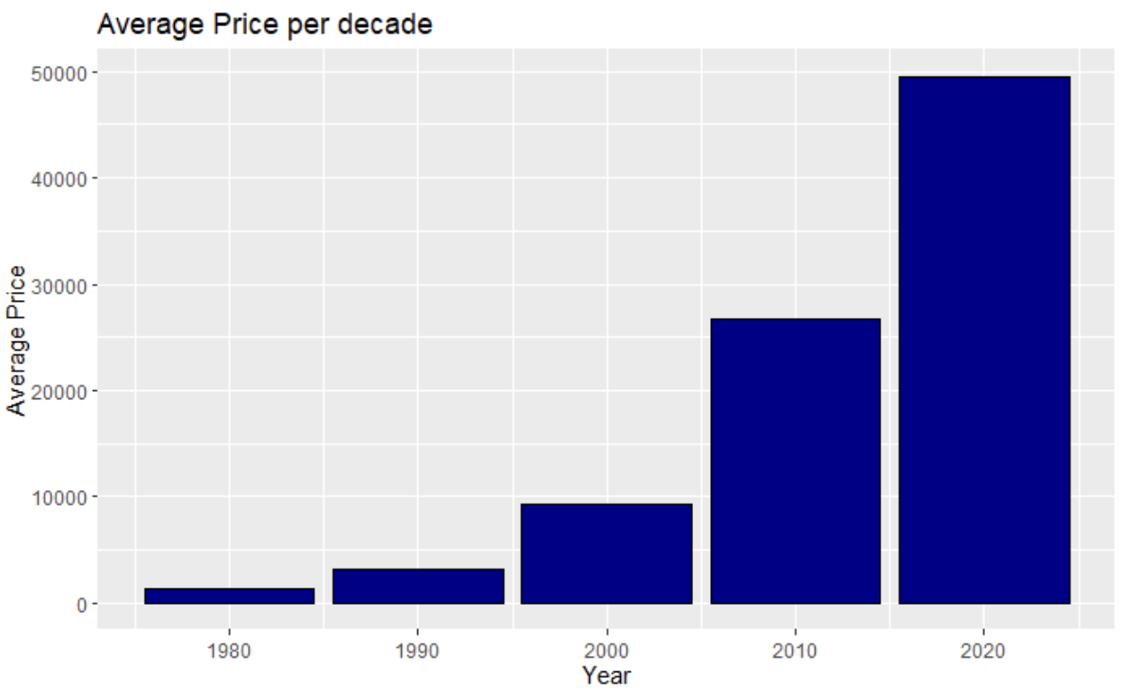
Average Vehicle Prices per Decade

Slide 8
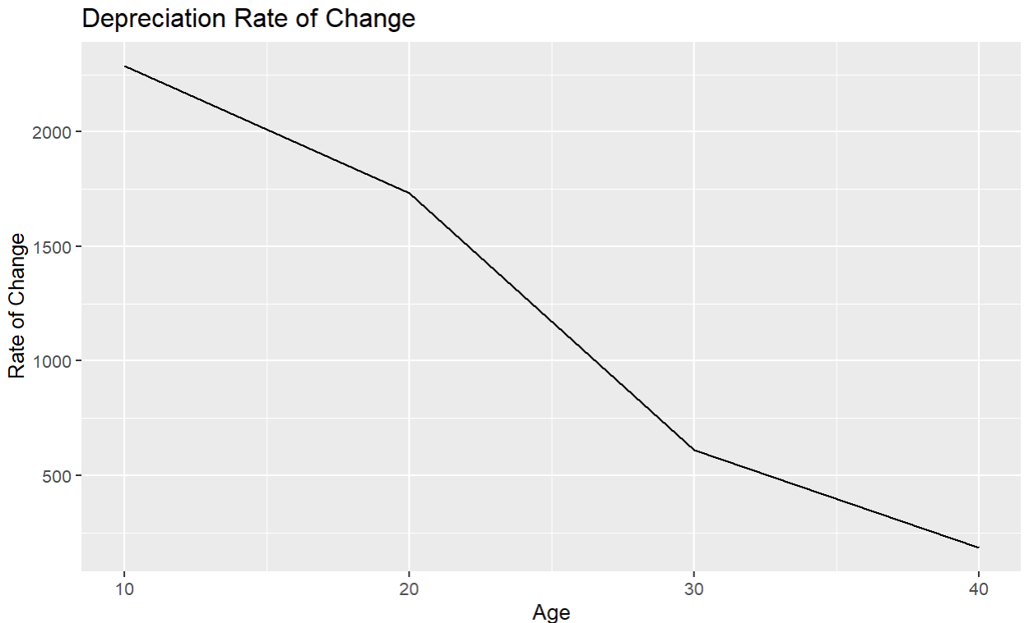
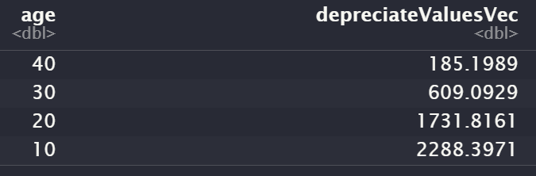
Average Depreciation per Decade

Slide 9
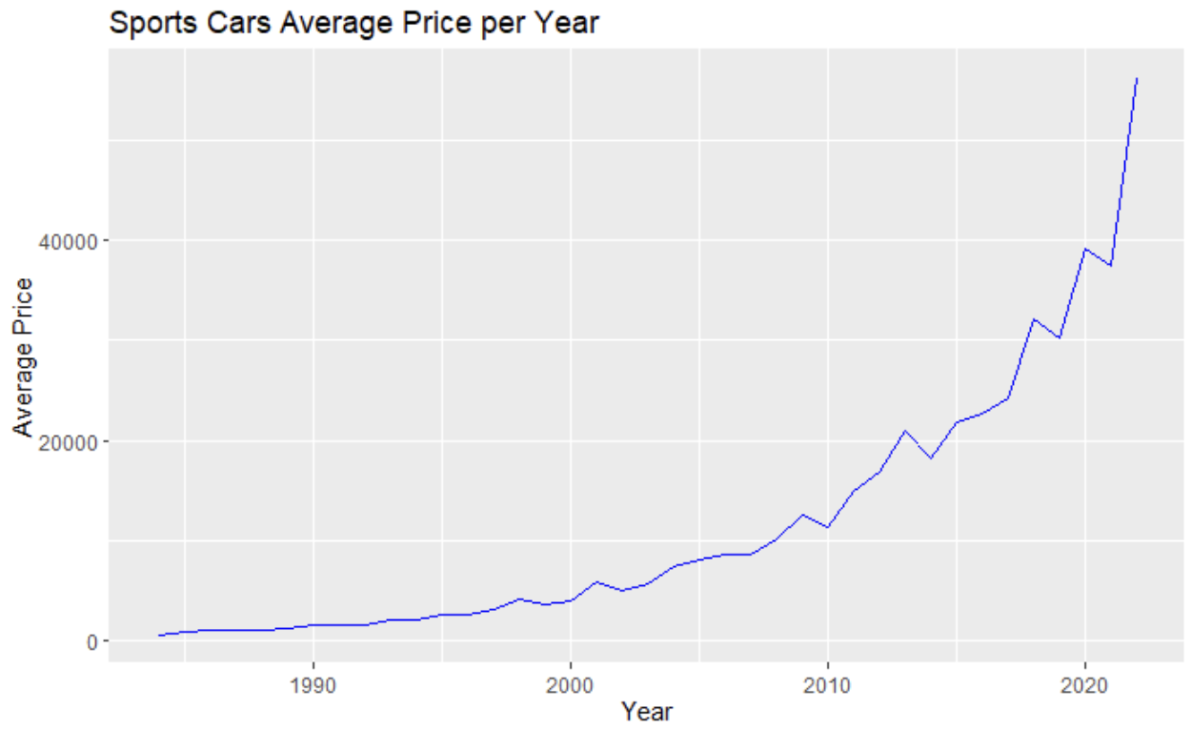
Average Price of Sports Cars

Slide 10
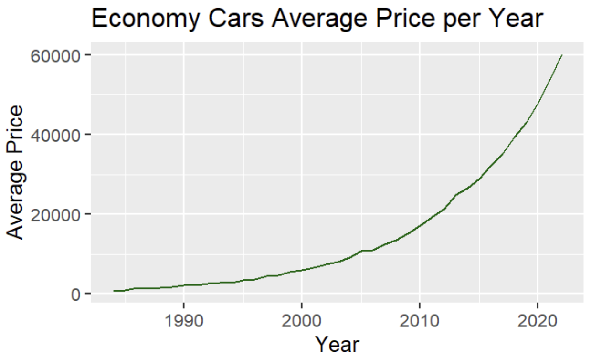
Average Price of Economy Cars

Slide 11
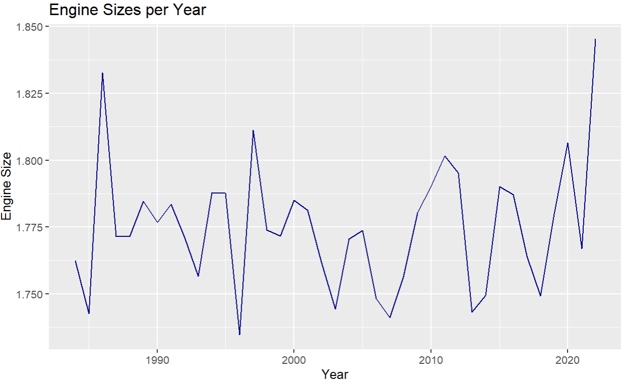
Average Engine Sizes

Slide 12
Results
We were able to see how vehicles depreciate per decade
How sports cars fluctuate in value
The growth of economy car prices
The exponential growth of price
Unable to explain price growth
Found limitatons

